Slide 1
Portfolio Optimization
Mean-Variance Optimization
Hierarchical-Risk Parity
The Critical Line Algorithm
Notes:
- Grouped the returns of the cash-and-carry strategy and the 'Google Trends' strategy together
- Sample period from 1/8/2020 - 31/5/2022
- Asset allocations were generated using the PyPortfolioOpt Library
- PyPortfolioOpt is a library that implements portfolio optimization methods
- Model Parameters --> frequency:365, log returns

Slide 2
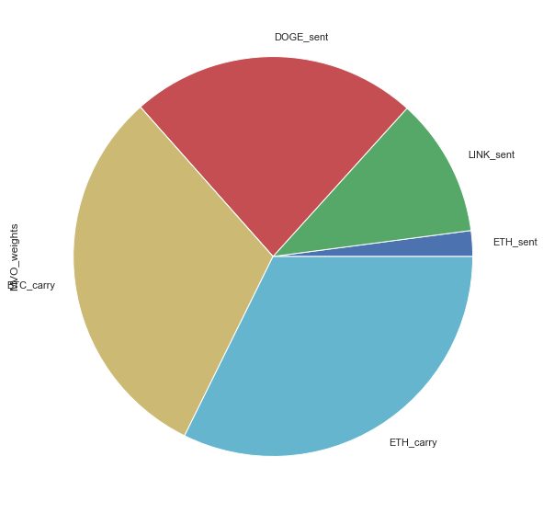
Mean-Variance Optimization
"Ledoit-Wolf" shrinkage - reduces the extreme values in the covariance matrix
exponentially-weighted mean of (daily) historical returns, giving higher weight to more recent data.
Strategy Assets | Asset Allocation
ETH_sent | 0.02077
LINK_sent | 0.11222
DOGE_sent | 0.23258
ADA_sent | 0.00000
BTC_carry | 0.31142
ETH_carry | 0.32301
Notes:
- The sample covariance typically is the default choice, but often has coefficients with extreme errors which are particularly dangerous in MVO because the optimiser is likely to make large allocations based on these coefficients.
- One possible improvement is to move extreme values towards the centre, in a process called shrinkage. This process may be significantly biased but has little estimation error as compared to sample covariance
- The exponential moving average is a simple improvement over the mean historical return; it gives more credence to recent returns and thus aims to increase the relevance of the estimates.

Slide 3
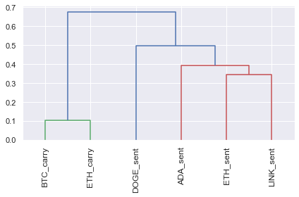
Hierarchical-Risk Parity(HRP)
How does HRP work?
From a universe of assets, form a distance matrix based on the correlation of the assets.
Using this distance matrix, cluster the assets into a tree via hierarchical clustering
Within each branch of the tree, form the minimum variance portfolio (normally between just two assets).
Iterate over each level, optimally combining the mini-portfolios at each node.
Notes:
- The advantages of this are that it does not require the inversion of the covariance matrix as with traditional mean-variance optimization, and seems to produce diverse portfolios that perform well out of sample.
- Downside is that its allocating only to the cash-and-carry strategy as it is the minimum variance portfolio

Slide 4
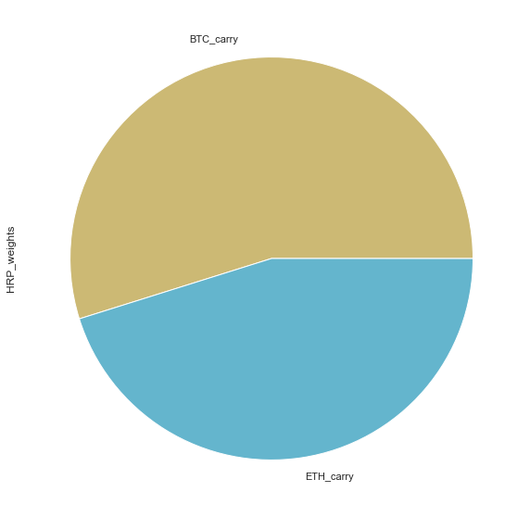
Hierarchical-Risk Parity
"Ledoit-Wolf" shrinkage - reduces the extreme values in the covariance matrix
Daily returns
Strategy Assets | Asset Allocation
ETH_sent | 0.00000
LINK_sent | 0.00000
DOGE_sent | 0.00000
ADA_sent | 0.00000
BTC_carry | 0.54843
ETH_carry | 0.45153

Slide 5
The Critical Line Algorithm
This is a robust alternative to the quadratic solver used to find mean-variance optimal portfolios, that is especially advantageous when we apply linear inequalities.
Unlike generic convex optimization routines, the CLA is specially designed for portfolio optimization.
It is guaranteed to converge after a certain number of iterations and can efficiently derive the entire efficient frontier.

Slide 6
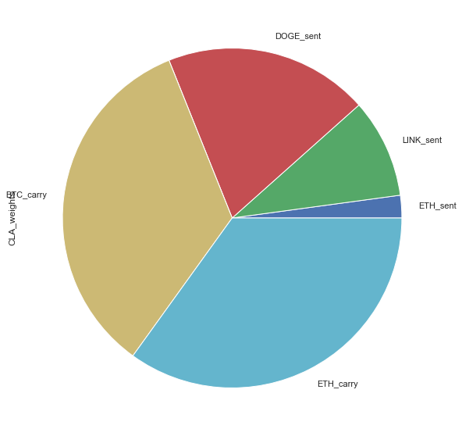
The Critical Line Algorithm
"Ledoit-Wolf" shrinkage - reduces the extreme values in the covariance matrix
exponentially-weighted mean of (daily) historical returns, giving higher weight to more recent data.
Strategy Assets | Asset Allocation
ETH_sent | 0.02146
LINK_sent | 0.09430
DOGE_sent | 0.19500
ADA_sent | 0.00000
BTC_carry | 0.33978
ETH_carry | 0.34946

Slide 7
Performance of Optimizers
 | MVO | HRP | CLA
Expected annual return | 91.5% | 7.7% | 78.5%
Annual volatility | 40.6% | 0.3% | 34.7%
Sharpe Ratio | 2.21 | 16.51 | 2.20

